Slide 1

Price Analysis of Restaurants Based on Different Characteristics

Slide 2

About us:
CH.Sandhya Rani M.sc(Statistics)
Work Experience: Fresher

Slide 3
Contents:
Problem statement
Tools Used
Raw data
Web Scraping
Data manipulation /Data cleaning
EDA(Exploratory Data Analysis)
Conclusion

Slide 4

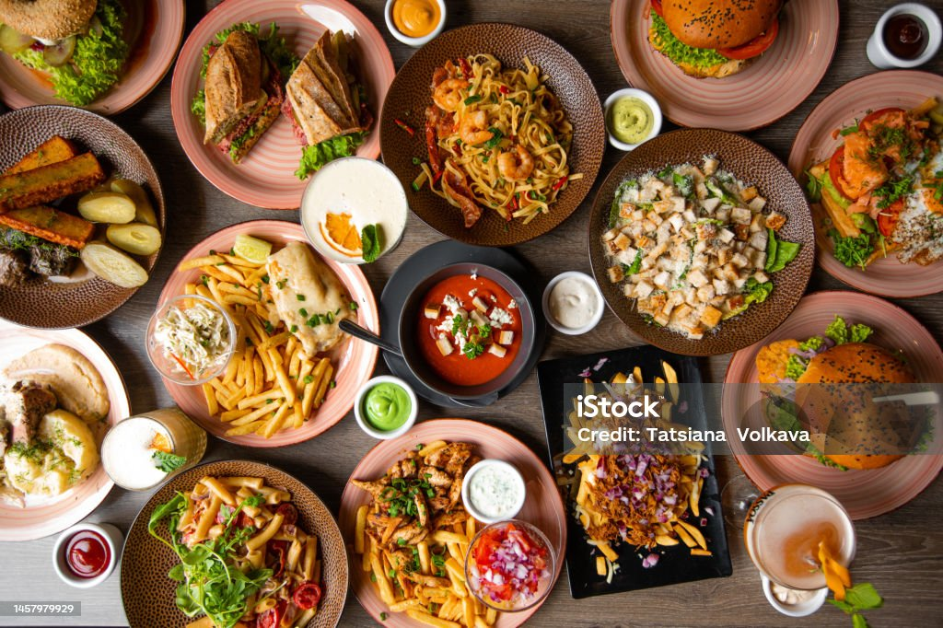
PROBLEM STATEMENT
One of my friend is planning a visit to Hyderabad
and is interested in obtaining details about the
prices of food in various restaurants across
the various region.

Slide 5





TOOLS USED:
Numpy
pandas
matplotlib
seaborn
requests
BeautifulSoup

Slide 6
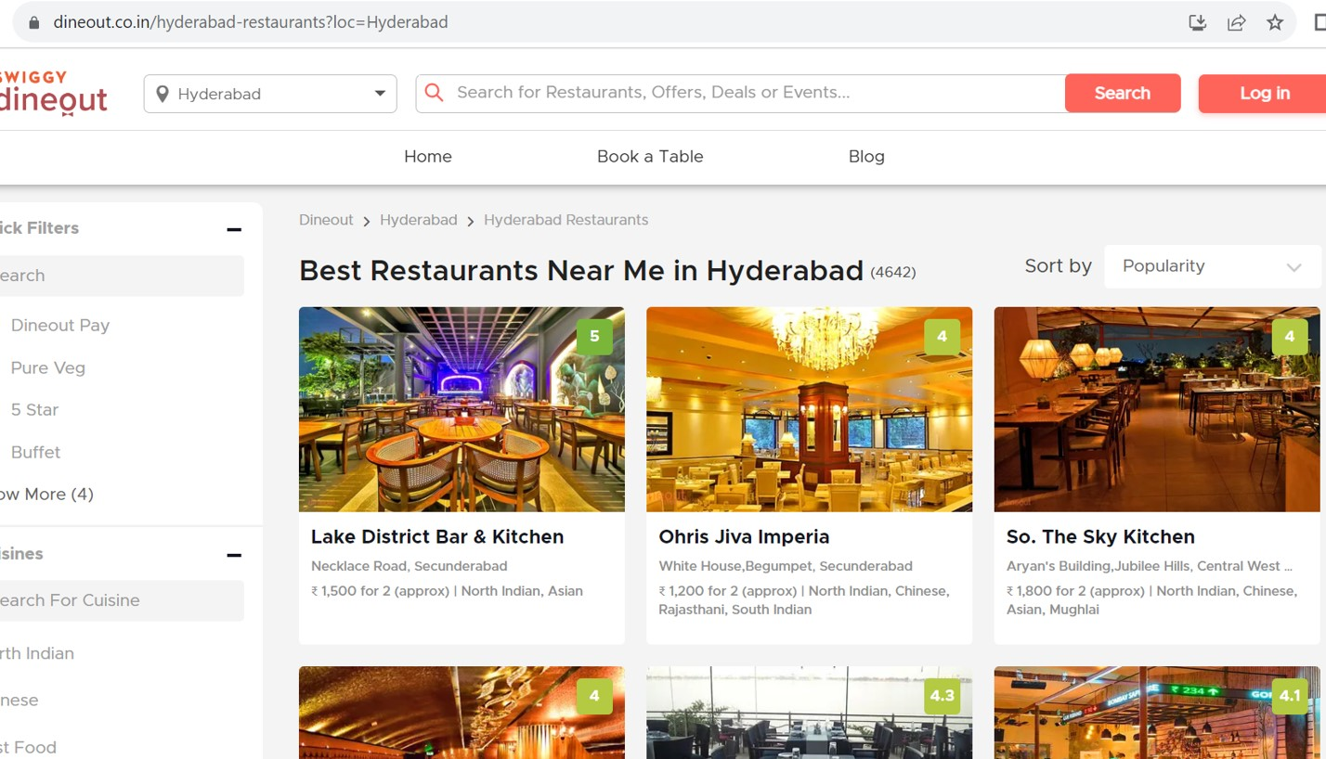
Website:

Slide 7
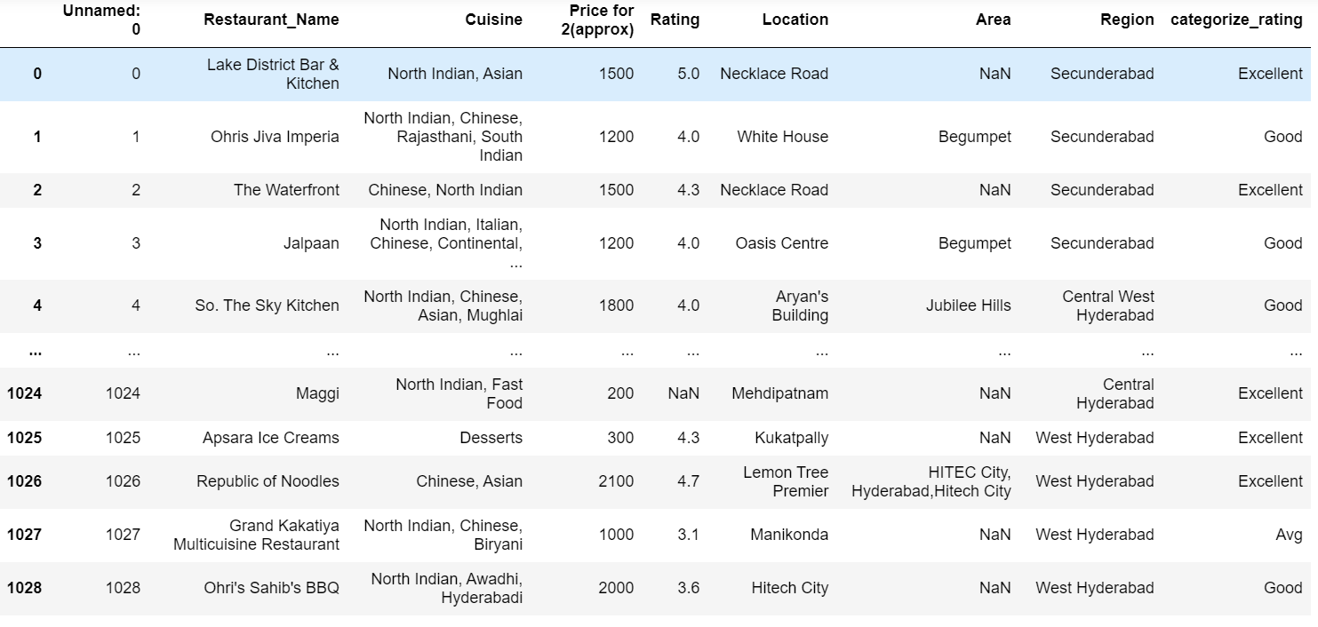
Raw Data:

Slide 8
Data cleaning Steps :-
Check for duplicates
No duplicates found
Removing structural errors
Identify and filling or drop the missing values
Data type conversion
Outliers

Slide 9
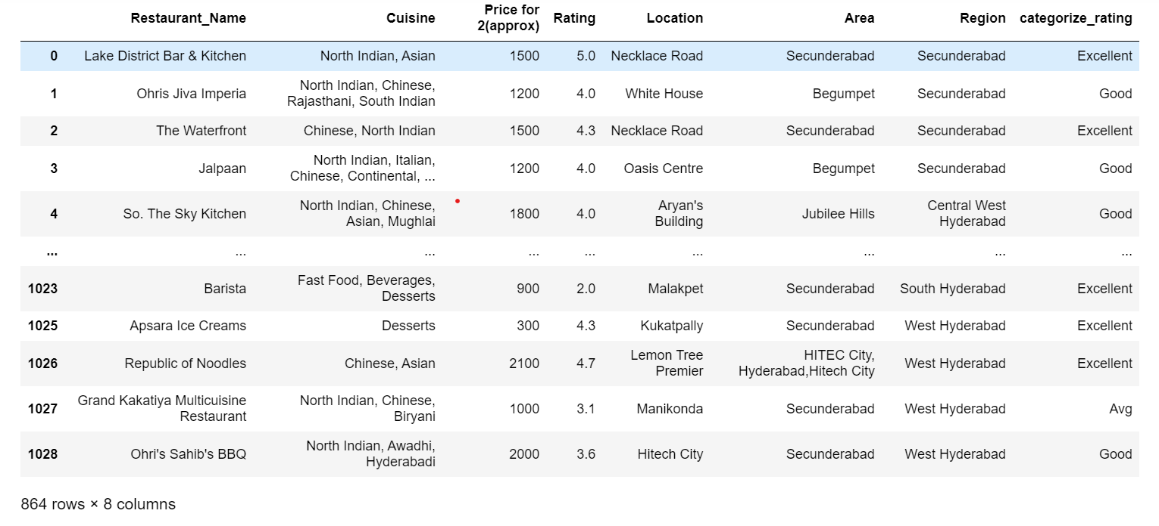
Cleaned Data:

Slide 10
DATA VISUALIZATION
Uni-Variate Analysis:
Uni-variate data consists of only one variable. It deals with only one quantity that changes.
Numerical
Categorical
Bi-Variate Analysis:
Bi-variate data consists of two different variables. It deals with find out the relationship among the two variables.
Categorical & Categorical
Categorical & Numerical
Numerical & Numerical
Multi-Variate analysis:
Multivariate analysis consists of more than two variables .It can be analysed simultaneously.
Two Categorical and one Numerical
Two Numerical and one Categorical
Three or more Numerical

Slide 11
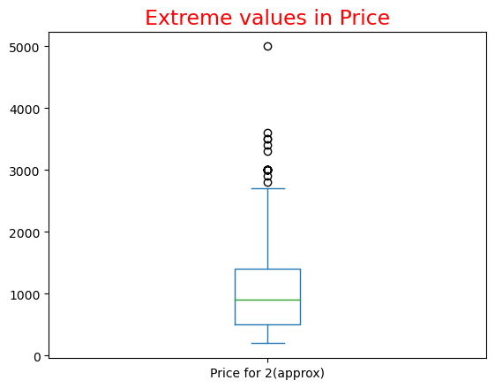
Given plot shows price in most of restaurants range from 200 to 2700.Greater than 2700 are extreme values

Slide 12
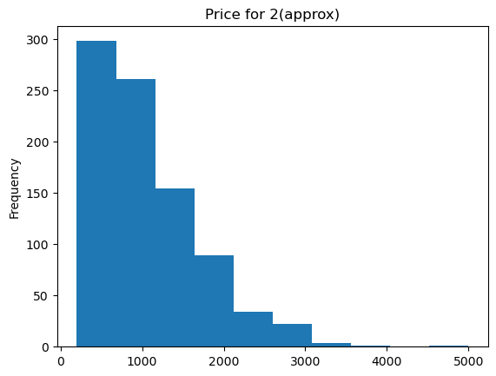
Few restaurants prices more than 3000.

Slide 13
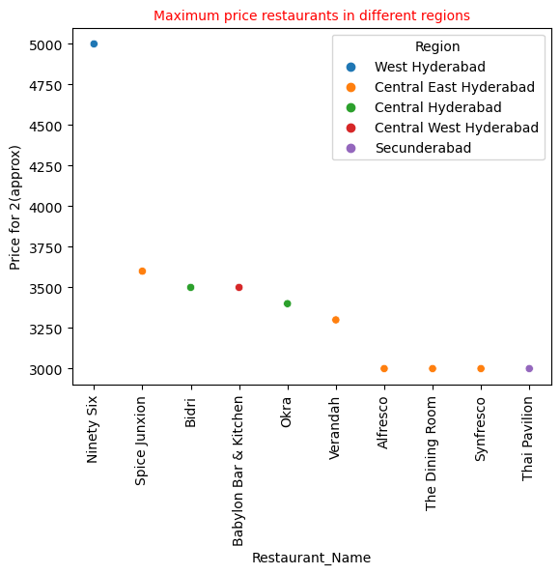
Ninety six in west Hyderabad has maximum price.

Slide 14
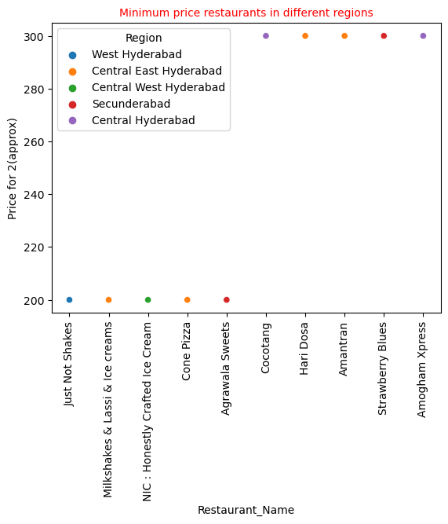
Minimum price in most of restaurants range from 200 to 300.
In all regions has minimum price
Restaurants.

Slide 15
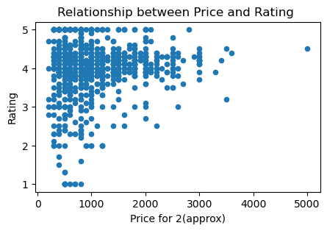
Given plot shows that restaurants which has more price it has chance that more rating

Slide 16
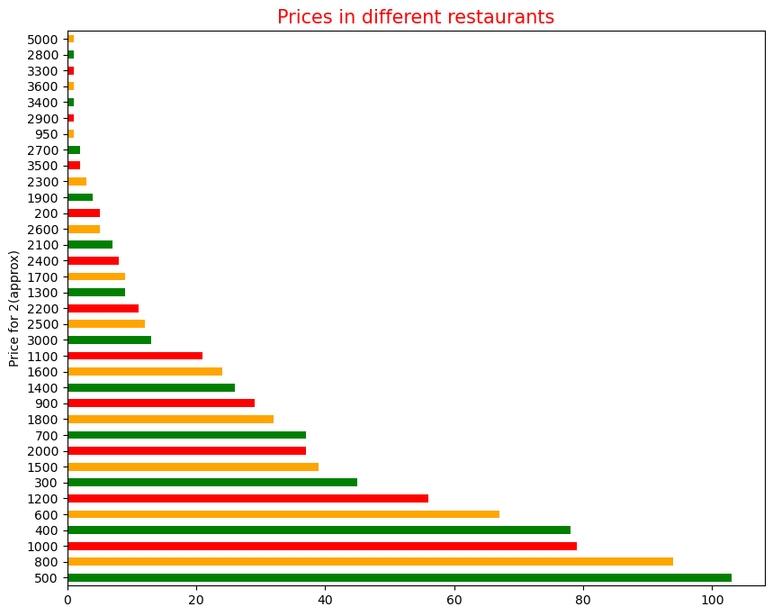
Prices in most of restaurants are budget friendly

Slide 17
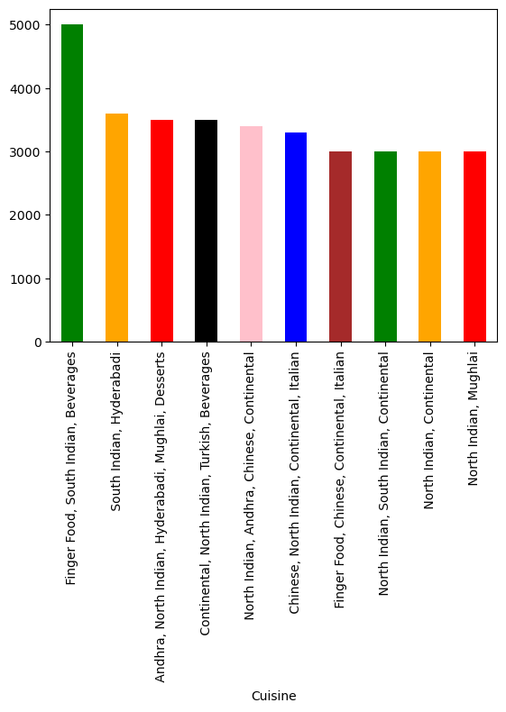
Cuisine
Plot shows the top 10 combination of cuisines offered by restaurants and their prices

Slide 18
Conclusion:
Prices in Most of restaurants are budget friendly ranges from 200 to 2700.
Minimum price range in most of restaurants is 200-300.
Maximum price in some restaurants ranges from 3000-5000.

Slide 19
Challenges Faced:
While web scraping faced lot of difficulties to extract the data initially.
By using regex extracted the data easily.
EX:
Cuisine = []
for i in soup.find_all('div', class_="restnt-main-wrap clearfix"):
text = i.find("span", class_="double-line-ellipsis").text
regex = re.findall(r'\|(.+)',text)
if regex:
Cuisine.append(regex[0])
else:
Cuisine.append(np.nan)

Slide 20

Thank you

